Slide 1
Drugs, Brain and Behavior
The Neuroscience of Addiction
Stephen Boehm, PhD
Professor of Psychology
Director, Undergraduate Neuroscience Program
IUPUI School of Science

Slide 2
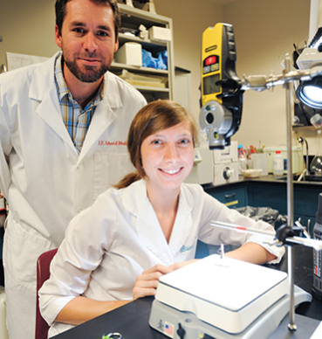
Addiction Research @ IUPUI
School of Science
Department of Psychology
*Boehm, *Cyders, *Czachowski, Goodlett, *Grahame, *Lapish, *Logrip, Neal-Beliveau, Zapolski
Department of Biology
Baucum, Marrs
Department of Mathematical Sciences
*Kuznetsov
School of Medicine
Department of Biochemistry and Molecular Biology
*Edenberg
Department of Medical and Molecular Genetics
Foroud
Department of Neurology
*Kareken
Department of Pharmacology and Toxicology
*Atwood, Yamamoto
Department of Psychiatry
*Bell, Chambers, *Engleman, Hopf, Hulvershorn, *Nurnberger, Oberlin, *Plawecki
Department of Radiology and Imaging Sciences
Yoder
*Indicates current affiliation with the Indiana Alcohol Research Center

Slide 3
T.-K. Li, MD
Dr. Li was also (1) founding director of the Indiana Alcohol Research Center, (2) former Fairbanks board member, and (3) former director of the National Institute on Alcohol Abuse and Alcoholism. He passed away on November 18, 2018 at age 84.

Slide 4
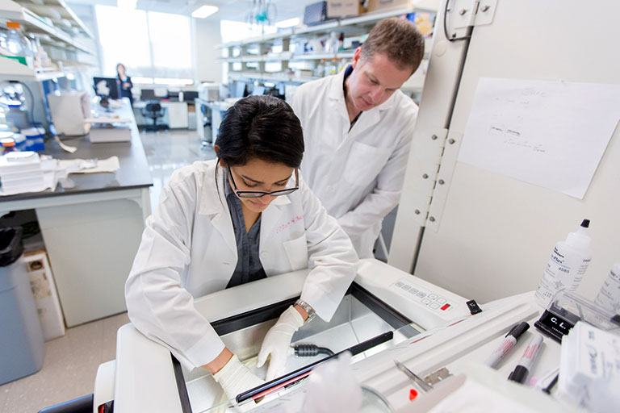
Addiction Research Training @ IUPUI
School of Science
Undergraduate
B.S., Neuroscience
199 students
Graduate
Ph.D., Addiction Neuroscience
14 students
Ph.D., Clinical Psychology
33 students
Ph.D., Biology
29 students
School of Medicine
Graduate
Ph.D., Medical Neuroscience
27 students

Slide 5
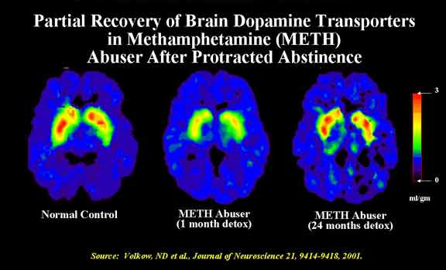
Brain Disease Model of Addiction
Functional recovery of the methamphetamine addicted brain. Imaging of dopamine transporter function by positron emission tomography.

Slide 6
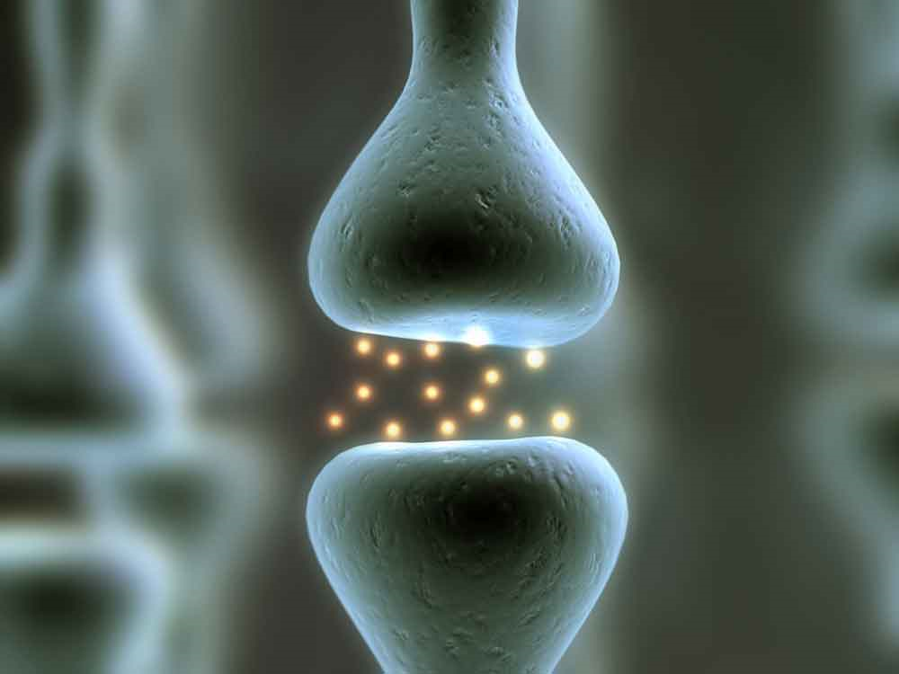
How Do Drugs Change Brain Function?
Drugs alter normal brain chemistry
Chemicals (neurotransmitters) in the brain and elsewhere allow cells to communicate
Neurotransmitters and Neurotransmission
Chemical released by one neuron onto second neuron that produces an excitatory or inhibitory effect in the second neuron
Excitatory or inhibitory effect determined by receptors on the second neuron
Examples: dopamine, serotonin, endorphin

Slide 7
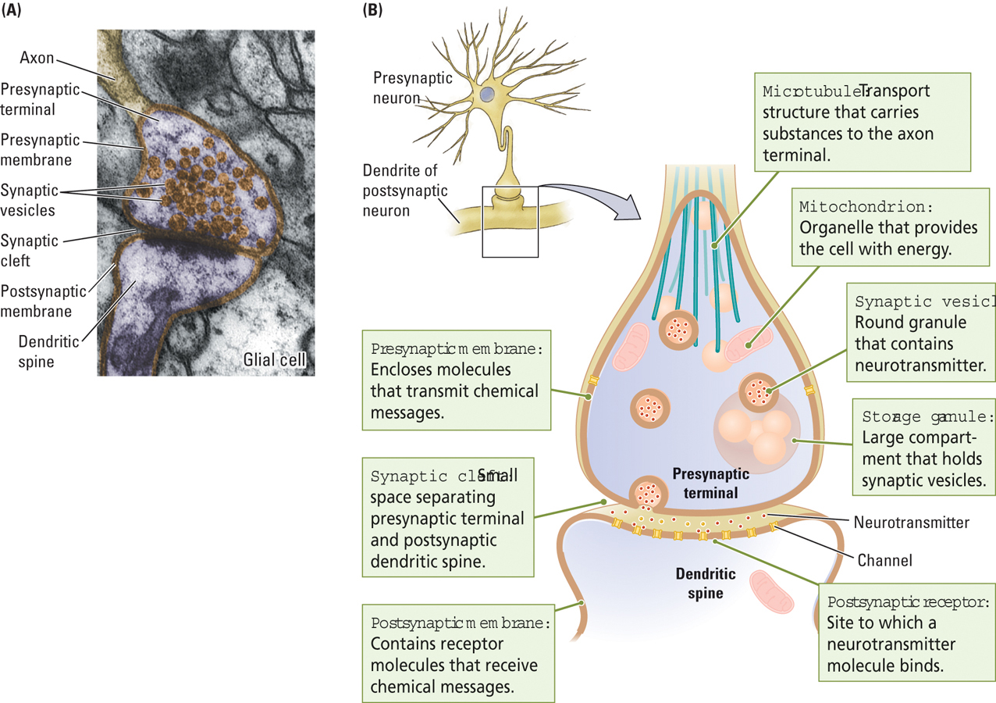
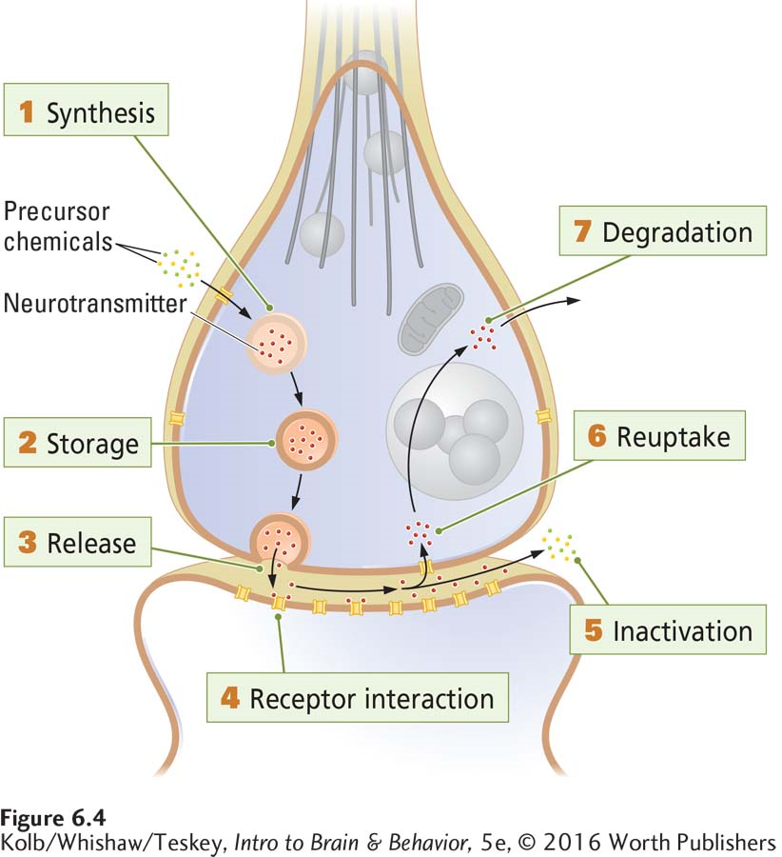
Neurotransmitters and Neurotransmission
Availability of neurotransmitters at the synapse must be carefully regulated

Slide 8
Drugs Alter Normal Neurotransmission
levodopa
methamphetamine
Cocaine
(and Methamphetamine)
Heroin
(and THC)
Naltrexone
(and Naloxone)

Slide 9
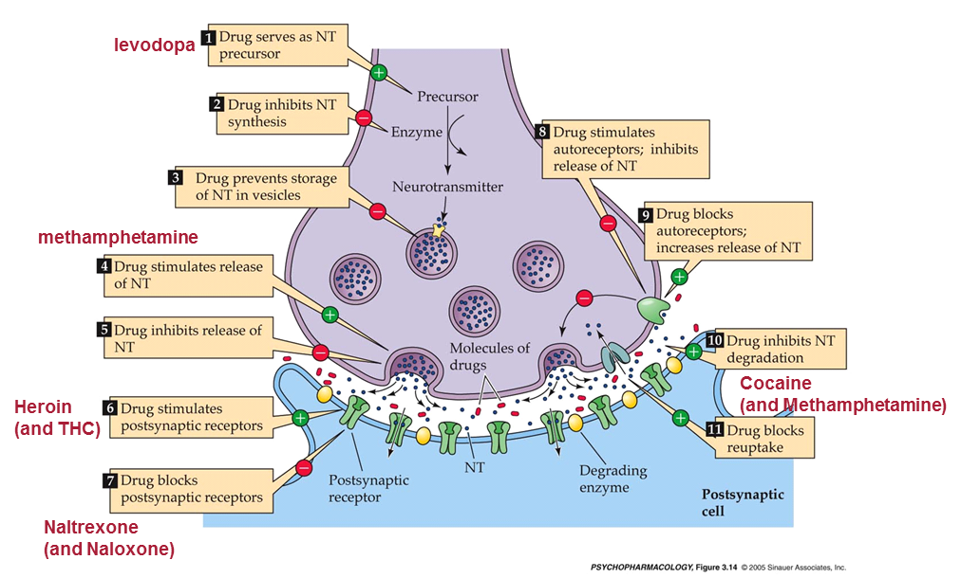
Chronic Drug Use Results in Neuroadaptation
Brain attempts to normalize function in continued presence of drug
Basis for tolerance, sensitization, and dependence
Tolerance
Reduced brain response following repeated drug exposure
Sensitization
Enhanced brain response following repeated drug exposure
Dependence
Altered brain function upon cessation of drug use
Often opposite of initial drug effect

Slide 10
Explaining Substance Use
A drug user may initially like the drug effects
However, after repeated use, drug tolerance, as well as psychological and/or physiological withdrawal symptoms, may develop (dependence)
At this point the drug user may want the drug even though he/she no longer likes it, resulting in compulsive drug use
Although a drug user may abstain from drug use for months…long after withdrawal symptoms have abated…he/she can still relapse
The field of Addiction Neuroscience seeks to explain the neurobiological basis of each of these phenomena

Slide 11
Major Theories Driving Addiction Neuroscience Research
Wanting-and-Liking Theory
Robinson and Berridge, 2008
Hedonic Homeostatic Dysregulation
Koob and Le Moal, 1997

Slide 12
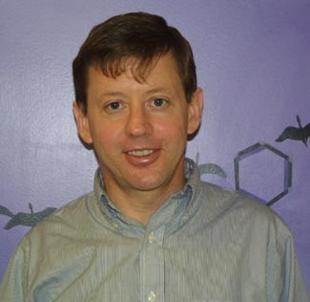
Wanting-and-Liking Theory
Incentive-Sensitization Theory
(Robinson and Berridge, 2008)
Wanting (craving) and liking (pleasure) of the drug both change over repeated drug use
Wanting:
Sensitizes with repeated drug use
craving increases
Striatal dopamine systems
Liking:
Tolerance develops with repeated drug use
pleasure decreases
Brainstem opioid systems

Slide 13
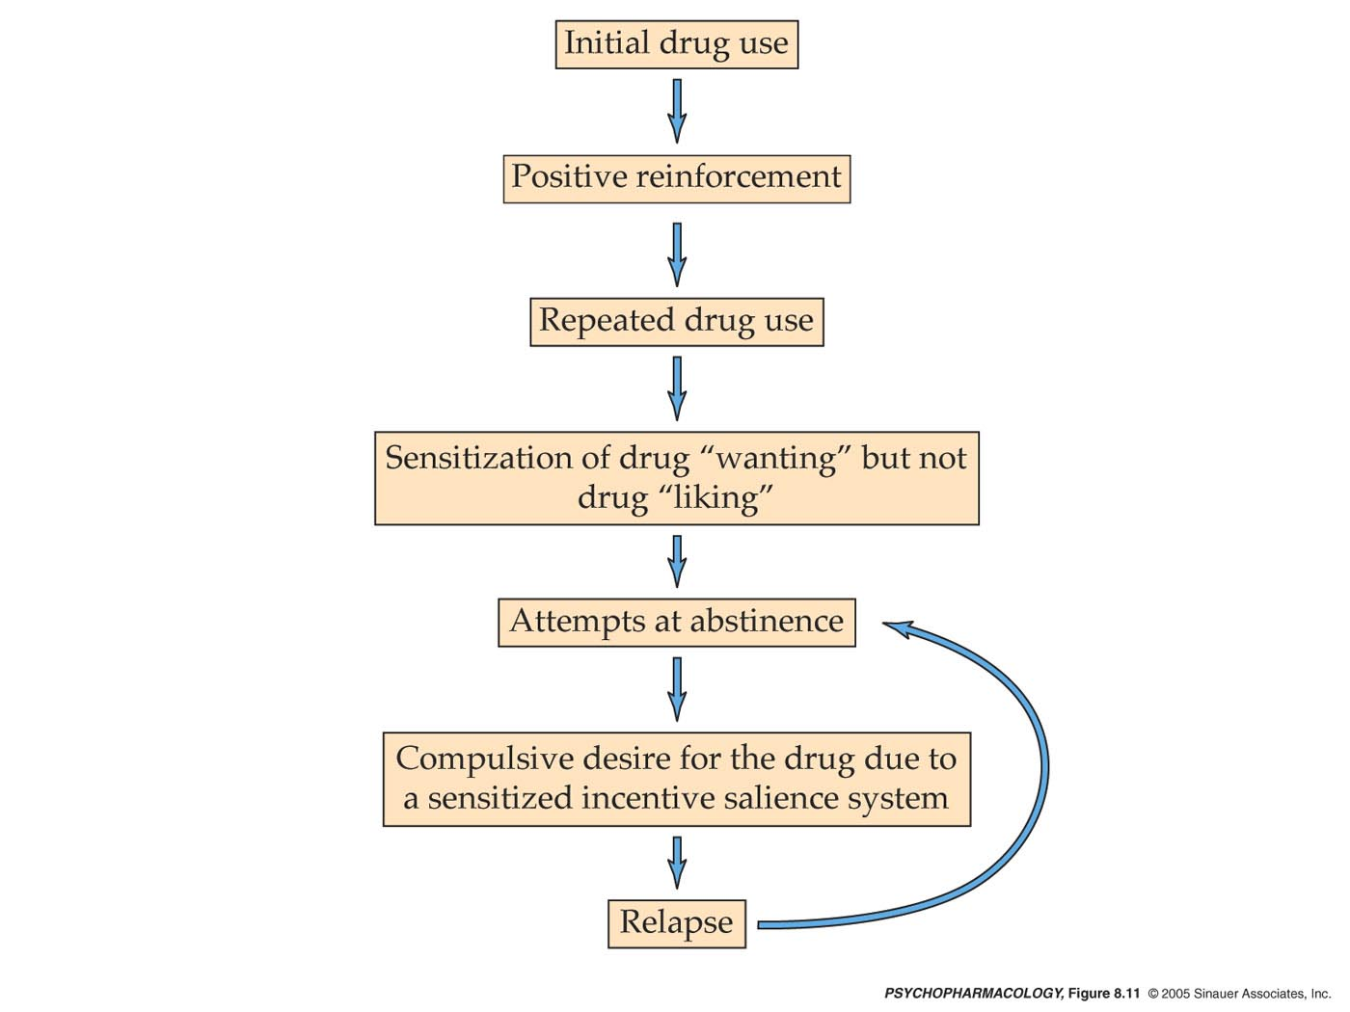
Wanting-and-Liking Theory
Robinson and Berridge, 1993
Wanting (craving)
undergoes sensitization,
or increases
Also known as ‘incentive salience’
Liking (the high)
does not change or
even undergoes
tolerance

Slide 14
Contemporary Wanting-and-Liking Theory
Decision to take a drug
frontal cortical glutamate systems
Pleasure (liking) associated with early drug use
brainstem opioid systems
Tolerance develops over repeated use
Craving (wanting) associated with chronic drug use
Ventral Striatal dopamine systems
Sensitization develops over repeated use
Voluntary control of drug taking gives way to unconscious processes – habit or compulsion
Dorsal Striatal dopamine systems

Slide 15
Hedonic Homeostatic Dysregulation
Allostasis (Koob and Le Moal, 1997)
Allostasis versus Homeostasis
Homeostasis:
Ability of a biological system to maintain a dynamic internal equilibrium in response to external and/or internal changes
Maintanence around set-point
Allostasis:
Biological response when external and/or internal changes are too large to be accommodated by homeostatic mechanisms
Creation of new set-point
Mood undergoes allostatic changes with repeated drug exposure
Based on Solomon and Corbit (1974) opponent-process model of motivation

Slide 16
Hedonic Homeostatic Dysregulation
Koob and Le Moal, 1997
Allostasis results in spiraling distress as the individual cycles through stages of drug use and creates new set-points for mood: Preoccupation Anticipation, Binge Intoxication, and Withdrawal Negative Affect

Slide 17
Hedonic Homeostatic Dysregulation
Koob and Le Moal, 1997
Key brain structures undergo neuroadaptation as the individual cycles through the Preoccupation Anticipation, Binge Intoxication, and Withdrawal Negative Affect stages.
Necessary for Allostasis, setting of new set-points

Slide 18
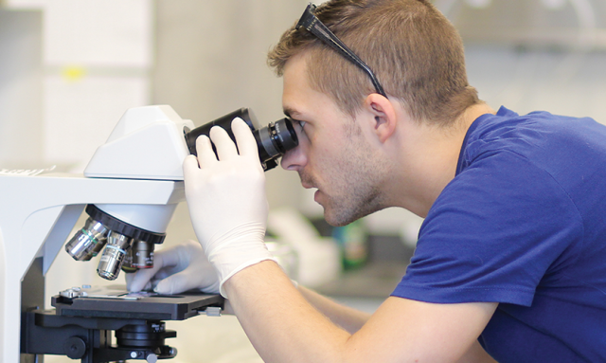
Addiction Neuroscience Research: Challenges
Studies in human populations
History of past drug use (exposure) is difficult to know
Dose, frequency, age at first use, poly-drug use
Extent of any drug tolerance/sensitization
Ethical barriers
Limit the extent of experimental drug exposure, manipulation of brain function
Studies using animal models
Do not recapitulate all aspects of Substance Use Disorder (DSM-V)
(1) Hazardous use, (2) social or interpersonal problems associated with use, (3) neglect of other roles in favor of use, (4) escalation of use, (5) repeat attempts to quit, (6) increased time spent using, (7) physical or psychological problems associated with use, (8) activities given up in favor of use, (9) tolerance, (10) withdrawal, (11) craving
‘endophenotypes’ of addiction must be studied

Slide 19
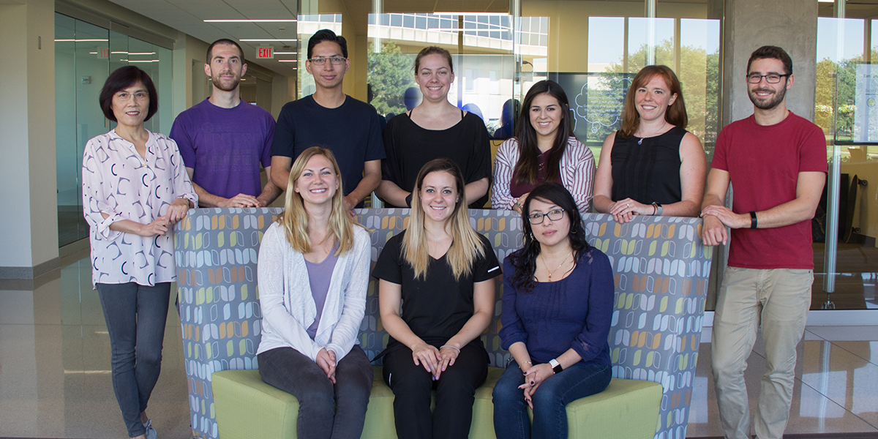
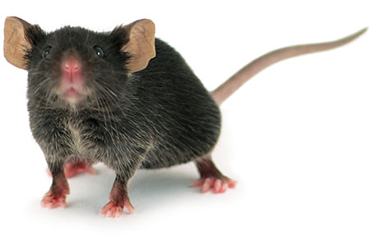
Boehm Lab
Genetic, developmental, and environmental determinants of drug intake and behavioral response in mice
Neurobiological underpinnings of drug intake in mice

Slide 20
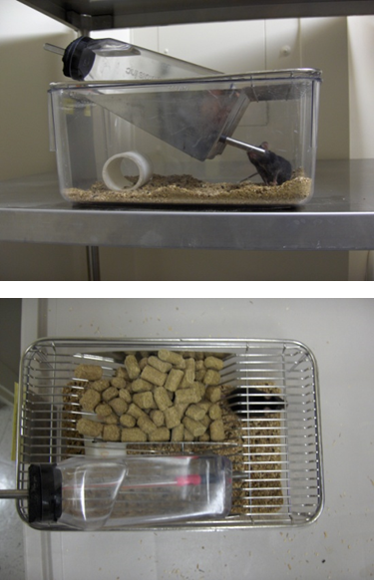
Modeling Binge Alcohol Drinking in Mice
Produces binge-like alcohol drinking, with blood levels exceeding 0.08 mg/dL
Mice display behavioral impairment, which undergoes tolerance with continued daily binge-like drinking
Mice escalate drinking over days, and develop front-loading behavior by about the 7th day
Adolescent mice are more avid binge drinkers than adults
Drinking-in-the-Dark

Slide 21
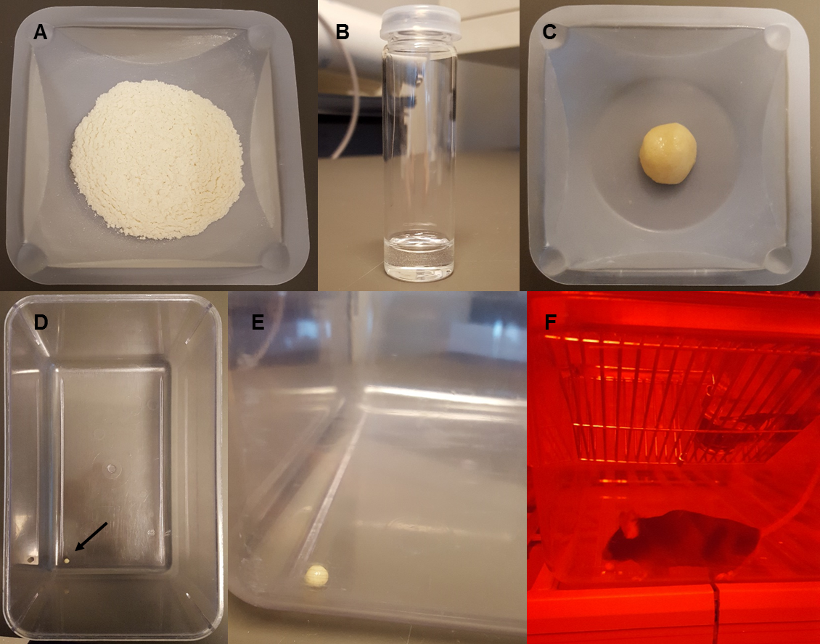
Modeling Edible Δ9-THC in Mice
Mice will routinely consume 5-10 mg/kg THC daily
Mice display behavioral impairment, which undergoes tolerance with continued daily consumption
Behavioral impairment blocked by a CB1 receptor antagonist
Adolescent mice will also engage in edible THC consumption
Flour, sugar, and salt
Glycerol
(+THC)
Dough ball
Dough ball
Dough ball
Consumption
Edible Δ9-Tetrahydrocannabinol (THC)

Slide 22
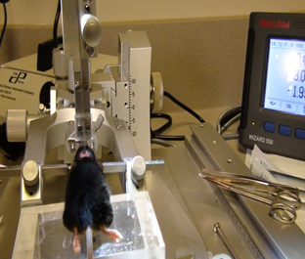
Active Boehm Lab Research Projects
IU Addictions Grand Challenge
Effects of childhood and adolescent low-level lead (Pb) exposure on drug intake and related behavior in adult mice
Indiana Clinical and Translational Sciences Institute
Effects of adolescent edible THC exposure on later adult brain and behavior in mice
National Institutes of Health / National Institute on Alcohol Abuse and Alcoholism
Role of dorsal striatal AMPA receptors compulsive-like alcohol drinking in mice

